Slide 1

Signal and Image Processing - Mod. 1
Tito Nicola Drugman - 502252
Angelica Pagni - 505887

Slide 2
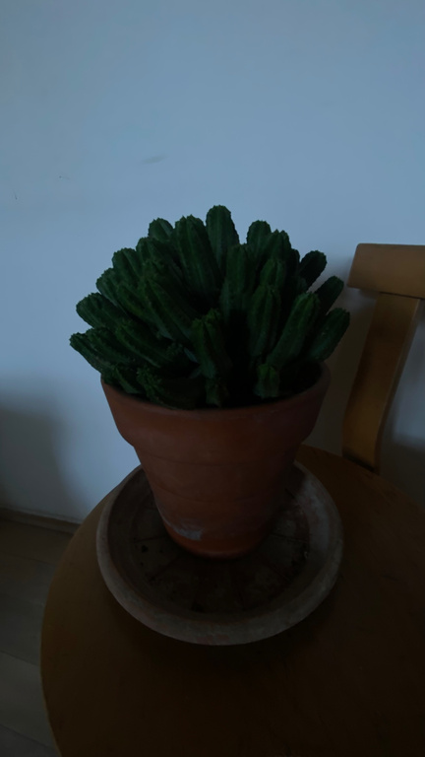
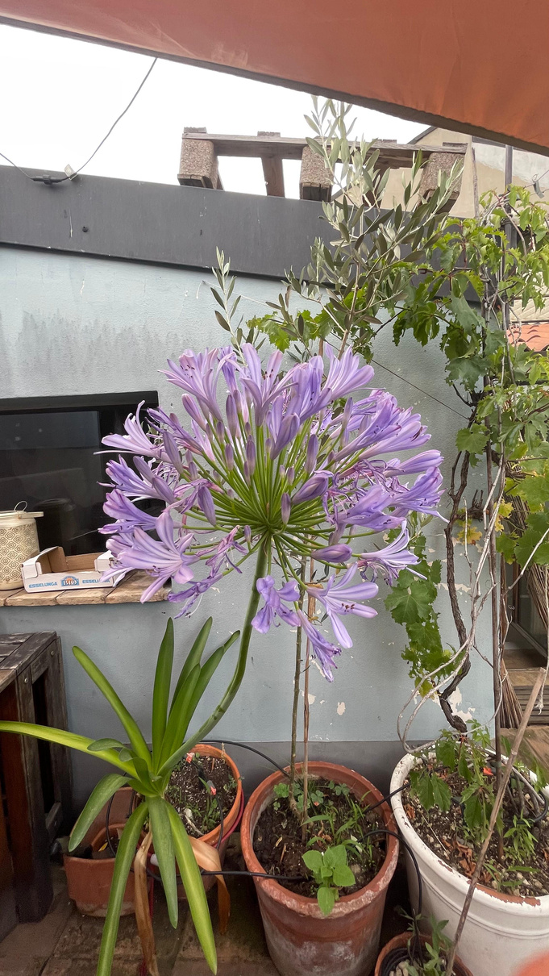
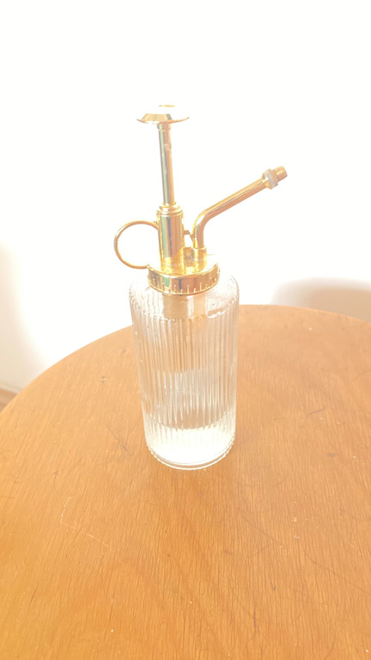
INTRODUCTION
Dataset
115 images
39 underexposed
42 correctly exposed
34 overexposed

Slide 3
1st section: Image Classification
GOAL:
Classify images into three exposure categories: overexposed, underexposed, and correctly exposed.
METHODOLOGY:
Convert images to YCbCr color space to isolate luminance (Y) component.
Create and normalize Y channel histogram.
Extract features: meanY, varY, skewY, minBinCount, maxBinCount.

Slide 4
Train-Test Split:
Divide data into 80% training and 20% testing sets.
Shuffle to remove bias and ensure representative samples in both sets.
Ensure each category is proportionally represented in training and testing data.
Feature Scaling:
Tried with both feature scaling and without. We had better results without feature scaling.
Scale only minBinCount and maxBinCount (which had higher magnitude).

Slide 5
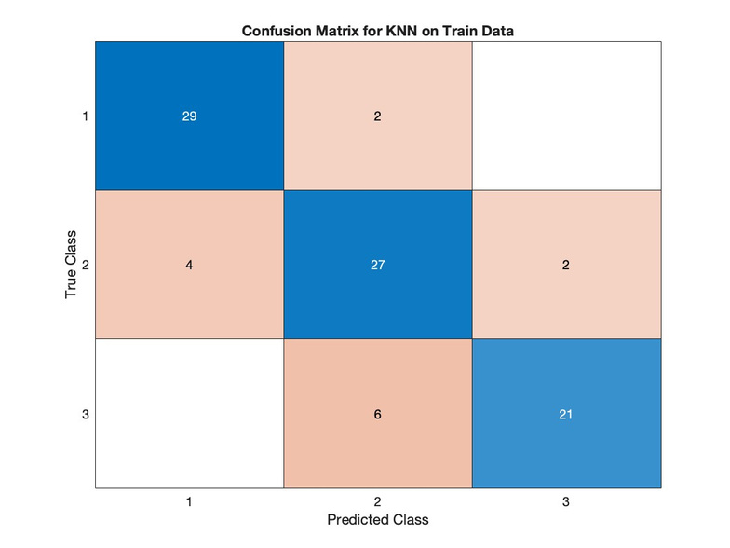
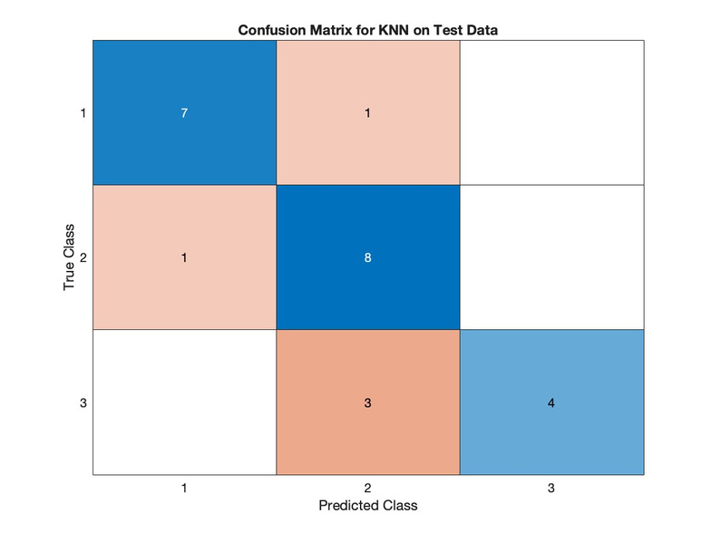
K-Nearest Neighbors (KNN):
Optimization:
Search for optimal k from 1 to 20 using cross-validation.
Elbow plot identifies best k based on minimum error rate.
Cross-Validation:
Implement 10-fold cross-validation on training data.
Evaluate each fold's performance to select best model.
Performance:
Train Accuracy KNN: 84.62%
Test Accuracy KNN: 79.17%

Slide 6
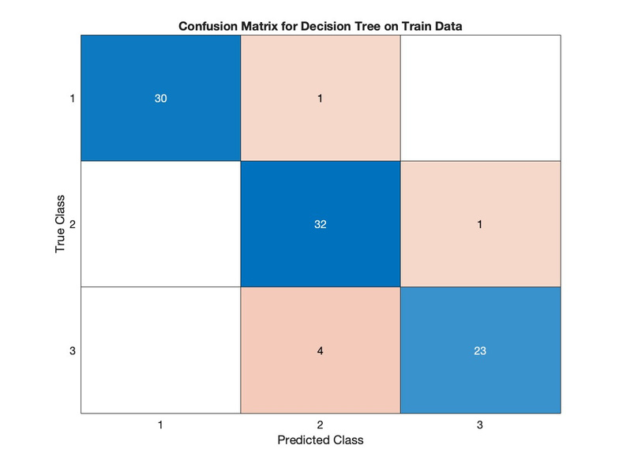
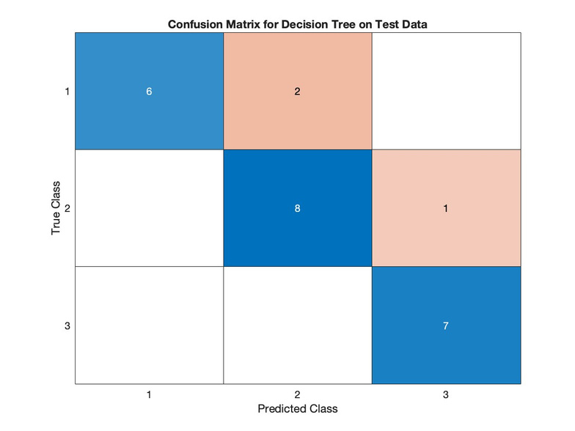
Decision Tree:
Model Selection:
Determine best Decision Tree model via cross-validation.
Assess accuracy and plot confusion matrices.
Performance:
Train Accuracy Decision Tree: 94.51%
Test Accuracy Decision Tree: 79.17%

Slide 7
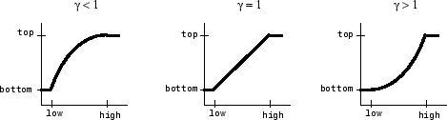
2nd section: Gamma Correction
Gamma values < 1 brighten the image, while gamma values > 1 darken the image.
Compute mean, variance, skew, minBinCount and maxBinCount of the correctly exposed images. Use them as targets.
fmincon to find the gamma value that minimizes the computed error.
Save the gamma/corrected images in a new folder.

Slide 8
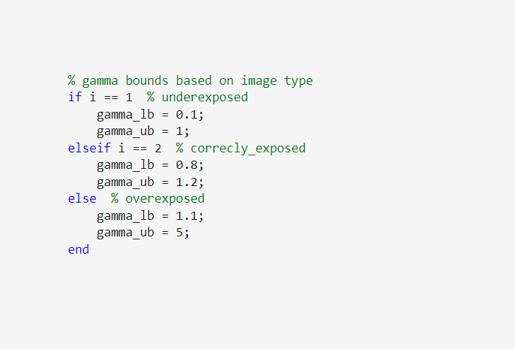
Gamma search space
Underexposed images have a range allowing brightening, and so the gamma search space was between 0.1 and 1.
Correctly exposed images have a tighter range around 1, for minor adjustment.
Overexposed images have a range allowing darkening, and so the gamma search space was greater than 1.

Slide 9
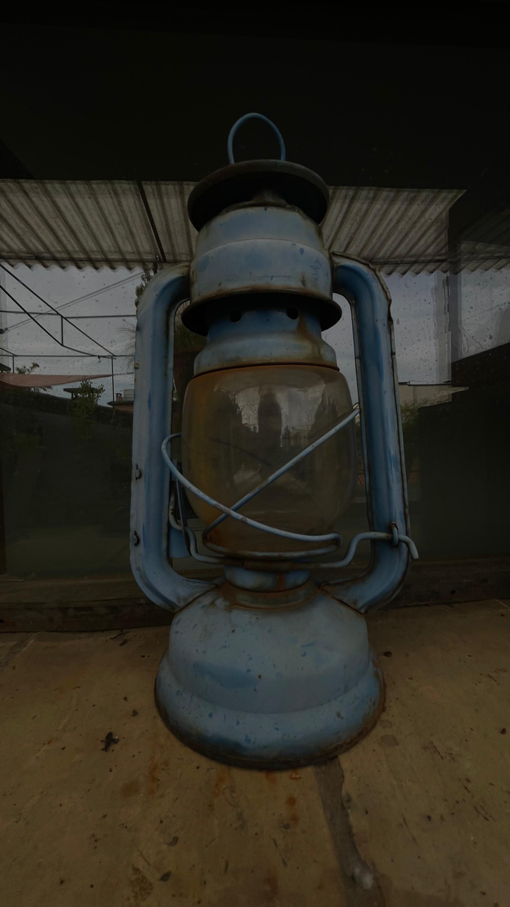
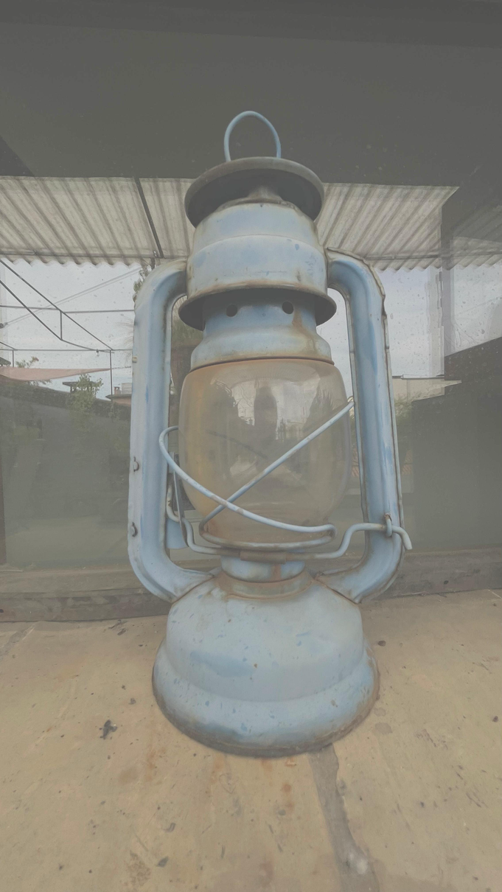
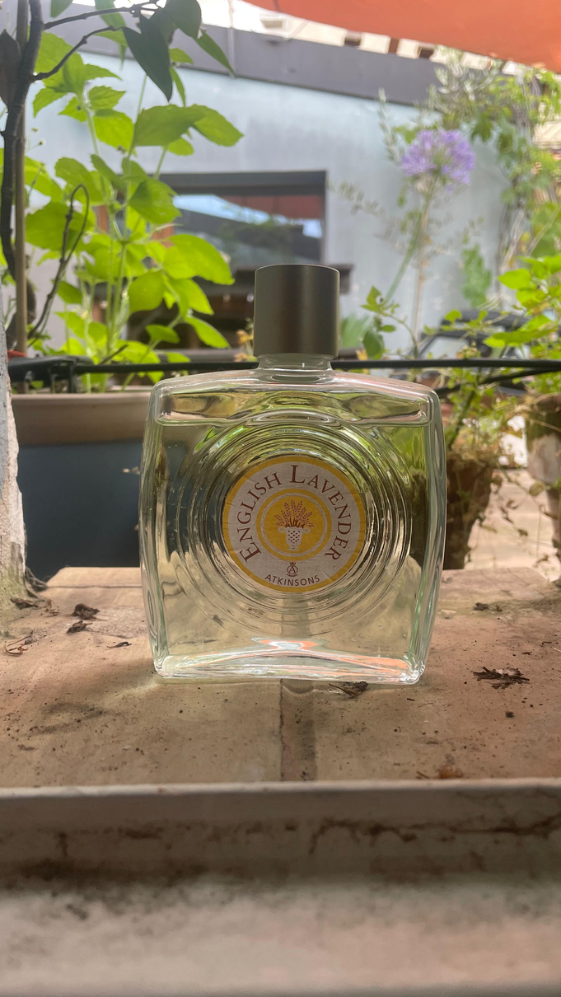
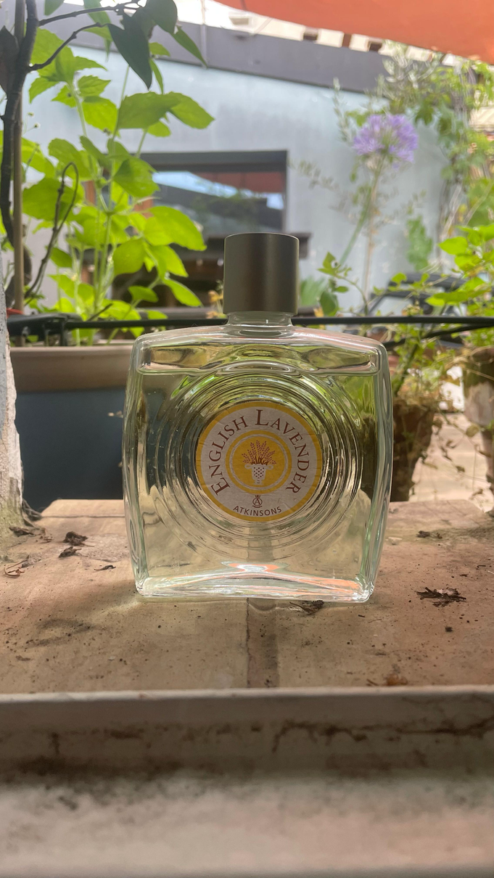
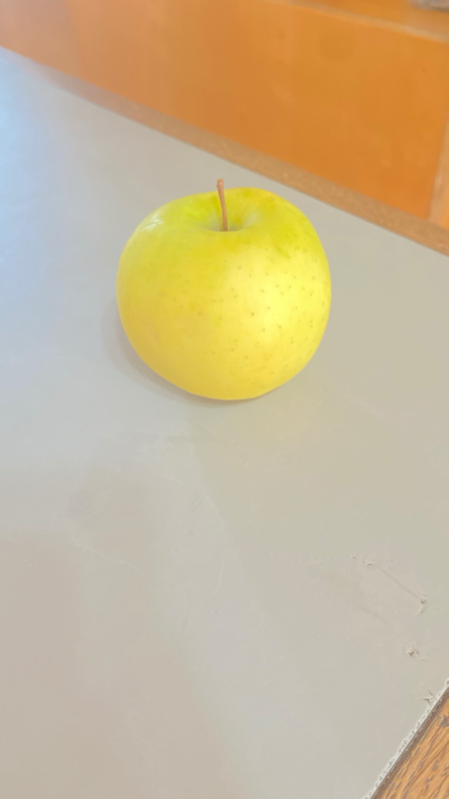
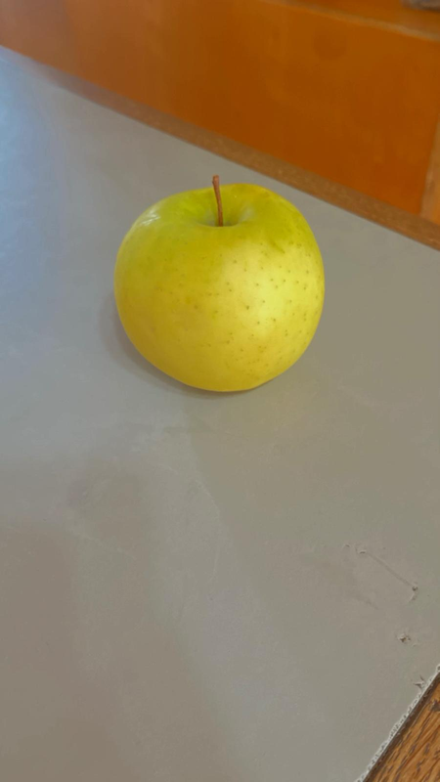
Results of the gamma correction
Undexposed
Gamma
corrected
Normal
Gamma
corrected
Overexposed
Gamma
corrected

Slide 10



KNN results
Underexposed
Correclty exposed
Overexposed
33
75
7

Slide 11
Decision Tree results
Underexposed
Correclty exposed
Overexposed
17
89
9

Slide 12
3rd section: Bonus
Statistics
NIQE Metric Overview:
No-Reference Image Quality Metric evaluates perceptual quality based on natural scene statistics.
Lower NIQE score indicates better perceptual quality by measuring image naturalness.
Methodology:
Applied NIQE to original and gamma-corrected images.
Assess improvement in perceptual quality post-correction.
Results:
Count images with lower NIQE scores after gamma correction.
Calculate percentage of images showing enhanced perceptual quality.

Slide 13
Entropy - Kurtosis
Entropy: randomness or unpredictability in the image data
Kurtosis: "tailedness" on the distribution, for presence of outliers or extreme deviations from the mean.
Compute from correctly exposed images the average entropy and kurtosis.
Then loop thought each image in the dataset and compute entropy and kurtosis before and after the gamma correction.

Slide 14
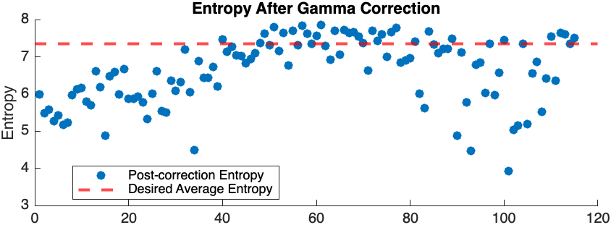
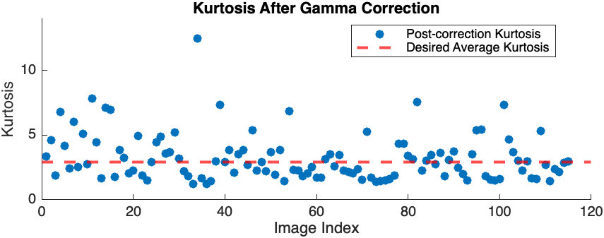
Entropy - Kurtosis

Slide 15
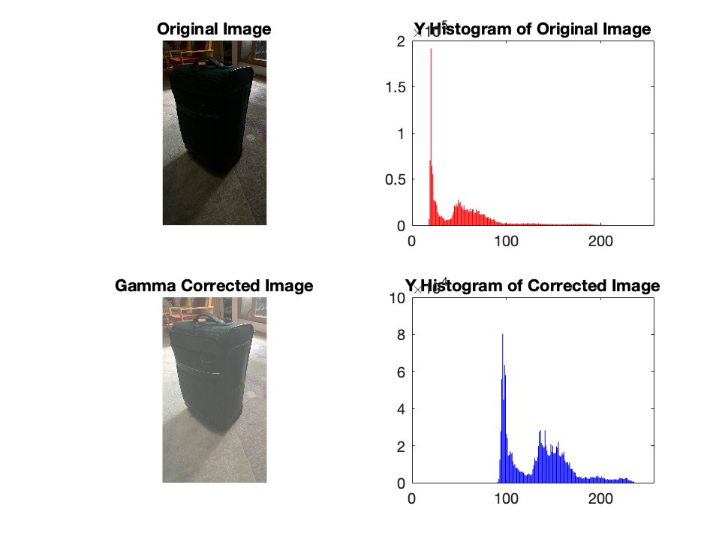
Example
img39.jpg before and after the gamma correction with the histogram (Y).

Slide 16
The end
Thank you!

